Slide 1
Graph Stories: How Four Metaphors Can Help You Decide if Graphs Are Right for You
Graphorum October 2019
Dan McCreary
Distinguished Engineer
Optum Advanced Technology Collaborative
Notes:
Hi – my name is Dan McCreary. I am a Distinguished Engineer working in the Advanced Technology Collaborative. I am leading the graph technologies initiative within the Advanced Technology Collaborative. Our goal is to build a collaborative community the use graph technology to lower the cost of healthcare and give Optum a competitive advantage in the marketplace.

Slide 2
Talk Description
We live in an increasingly complex world where strategic technology decisions are made by people that may not understand how technology works. You can take control of your company’s data strategy if you control the stories and metaphors that are presented to decision makers.
In this session, we will give examples of how organizations are using storytelling to help guide their data architecture and how you can customize and test these processes to ensure executive support for your key data initiatives.

Slide 3

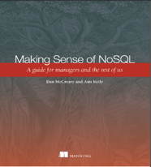
Hello, my name is
Dan
Distinguished Engineer in AI and Graph Technologies at Optum’s Advanced Technology Collaborative
Optum is part of United Health Group (Fortune 5)
300K+ employees (48,000 IT employees)
Co-founder (with Tony Shaw) of the NoSQL Now! conference (now part of Dataversity’s Database Now! conferences)
Co-author of "Making Sense of NoSQL" (with Ann Kelly)
Background in Solution Architecture
Interest in cognitive bias in database selection
Disclaimer: All opinions are my own and may not reflect the views of my employer
Notes:
My background is a solution architect. I have spent most of the last 20 years understanding how to objectively match business problems to the appropriate technologies. My focus has been on the fast-evolving area of NoSQL databases. I have also had a strong interest in AI, semantics, natural language process and search.

Slide 4
Key Questions
Why is storytelling important in helping decision makers? How are metaphors used in storytelling?
How can I explain graph databases to non-technical decision makers?
How can I tell stories that illustrate how graph databases are different from RDBMS?
How can we used these stories to promote graph for the right use cases in our organization?
Can we test if our storytelling works?
How do graph databases promote explainable predictions?

Slide 5
Graph is a “NoSQL” Data Architecture
Relational
Analytical (OLAP)
Key-Value
key
value
key
value
key
value
key
value
Column-Family
Graph
Document
See Chapter 1: https://www.manning.com/books/making-sense-of-nosql
Notes:
OK, now lets take a step back and take a more structure look at where these tools fit into our business processes at Optum.
There are six main database architecture patterns we use when we think of a business problem.
Relational or row-stores
Analytical or OLAP
Key-Value stores – one of the simplest but most extensible data architectures
Column-family stores
Graph stores
and Document stores
Graph is just one of these six. Graph stores are often most closely related to document stores. Both Graph and document stores have the ability for new data to be added to structures without needing to remodel the data. We call these systems schema-free or schema agnostic. They are a key driver for highly agile systems.
Your systems may often draw on two or more of these systems. Databases that support multiple data models are called multi-model databases. They prevent us from having to store the same data over in multiple systems for transactions, search and analytics. Multi-modal systems that integrate graph technologies are also an emerging trend.

Slide 6

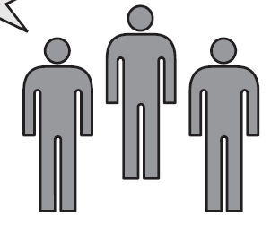
Role of the Solution Architect
Help!
Relational
Analytical (OLAP)
Key-Value
k
v
k
v
k
v
k
v
Column-Family
Graph
Document
Business Unit
Sally Solutions
Title: Solution Architect
A Solution Architect provides an objective (unbiased) matching of business problem to the right data architecture …
…and also may need to be a storyteller!
Notes:
Lets now take a look at the role of the solutions architect is to select the RIGHT data architecture based on the requirements of the business unit. Let’s call our main character Sally Solutions. When a business unit comes to Sally her job is to understand their high-level requirements and match the problem at hand to the right database architecture. Ideally she would do this before anyone starts to look at products.
The entire point of this session is to make sure we all understand when graph databases and graph technologies should be considered an option. Graph need to be one of the architectures considered.

Slide 7
Architectural Tradeoff and Analysis Method (ATAM)
Business
Drivers
Quality
Attributes
User
Stories
Analysis
Architecture Plan
Architectural
Approaches
Architectural
Decisions
Tradeoffs
Impacts
Sensitivity
Points
Non-Risks
Risk Themes
Distilled info
Risks
The ATAM process defined by CMU's Software Engineering Institute (SEI)
Notes:
Let me introduce you to the Architectural Tradeoff and Analysis Method or ATAM method.
ATAM is a proven structured process developed by Carnegie’ Mellon's Software Engineering Institute to objectively analyze the tradeoffs when selecting an architecture or database. The process has two main paths:
Helps is understand the architecturally significant requirements that help us drive the selection process
The second path helps us understand what possible options we can take. We want Graph databases are one of the Architectural Approaches. This is the center box in the 2nd row.

Slide 8
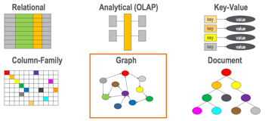
Graph Databases as an Architectural Approach
Business
Drivers
Quality
Attributes
User
Stories
Analysis
Architecture Plan
Architectural
Decisions
Tradeoffs
Impacts
Sensitivity
Points
Non-Risks
Risk Themes
Distilled info
Risks
We want all appropriate architecture options to be considered including graph databases….but we still have to convince business owners to use newer technologies when appropriate.
Notes:
So how do the six options fit in? We want graph databases to be consider fairly along with existing legacy systems. Once you have a list of the options you can compare how hard it will be do do your critical user stores for each architecture. If a process is really easy in a graph but more difficult in a relational database you can see this in your analysis.
Although we will not go into the fine details of doing this analysis, called utility tree analysis, we want you to be aware of the process and be willing to bring in experts to help you use this process to objectively know when graph technologies should be used.

Slide 9
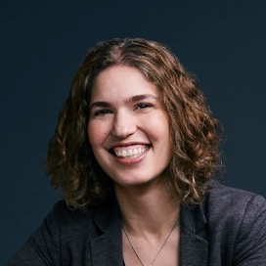
Why Metaphors Matter
“Metaphors drive design decisions”
GraphConnect Keynote 2018
We make decisions not by having a deep understanding of how technology works, but through being exposed to the right metaphors.
Hillary Mason
Data Scientist
Notes:
https://neo4j.com/graphconnect-2018/ around 51 minutes in
Great Solution Architects help business decision makers make the right stories

Slide 10
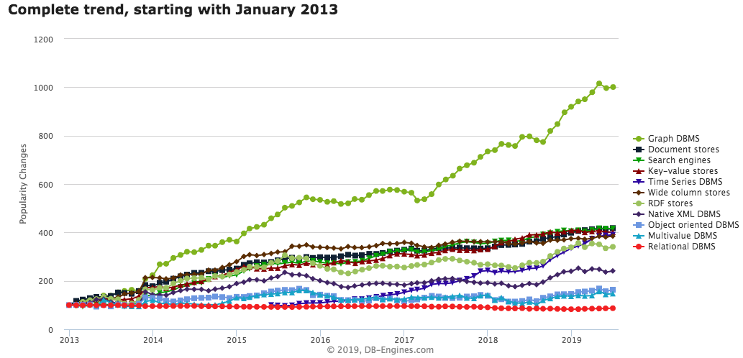
Graph Databases are HOT!
Graph Databases
https://db-engines.com/en/ranking_categories
Notes:
This chart shows the relative change in popularity of graph databases compared to other technologies according to DB Engines. DB Engines has web crawlers that regularly harvest an classify data related to databases. You can see that Graph Database popularity is the fasting growing database technology. This trend started in 2013 and it is continuing strong in 2018. Note that is is not absolute popularity. This is the change is popularity. Popularity also does not imply suitability. However, with these disclaimers aside you can clearly see a sustainable trend. Let’s see what other evidence we have about the rise of graph technologies.

Slide 11
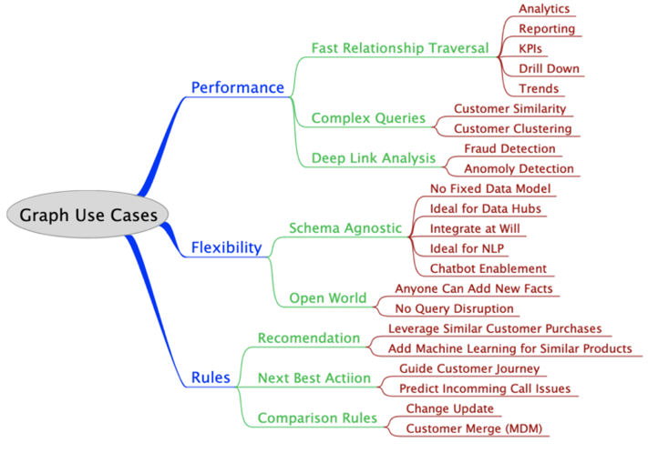
When to Use a Graph Database
A Taxonomy of Graph Use Cases
Notes:
https://medium.com/@dmccreary/a-taxonomy-of-graph-use-cases-2ba34618cf78

Slide 12
Successful Graph Evangelism is Connecting the Dots
CIO
Executive sponsor: understands the strategic nature of graph
Manager
Manager
Non technical people that will block graph initiatives.
Manager
Manager
Developer
Developer
Developer
After three months working on graph they never will go back to relational databases.

Slide 13
Stories Retelling is Tested When You are NOT in the Room
Graph
Evangelist
Idea transmission to their internal teams is dependent on their recall of the stories
Team 1
We often assume that our audience has perfect memory and can recall everything we said.
We rarely know who the real trusted advisors are to the decision makers.
Team 2

Slide 14
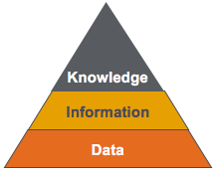

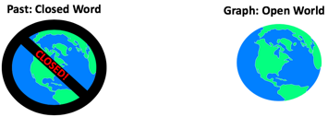
Four Graph Metaphors
The Neighborhood Walk
index free agency, performance
The Knowledge Triangle
data, information and knowledge
The Open World Assumption
graph integration, agility
The Jenga Tower
the resilience of graphs to change

Slide 15
The Neighborhood Walk
comparing relationship traversal performance
Notes:
https://medium.com/@dmccreary/how-to-explain-index-free-adjacency-to-your-manager-1a8e68ec664a

Slide 16
Relational vs. Graph
Relational (row store)
Graph
ID
NAME
DATE
AMOUNT
Atomic unit of storage is a row of a table
Data is appended one row at a time
All columns within a table must have the same structure and no variations within a table are allowed
Table structures are fixed after design
Joins are done at query time using a log(N) search's against other tables
Atomic units of storage are nodes and edges
Each node and edge may have independent properties
Relationships are are stored as memory pointers calculated when the data is loaded
Each core hops through 2M edges/second (1,000x faster than joins)
All verticies and edges must fit in RAM for fast access
Notes:
Now lets do a side-by-side comparison of both the traditional Relational row-store and compare some key facts. With a row store, the atomic unit of work is adding a single row at a time to a table. The key is that all the datatypes in each column must be the same. If there are dates in the third column and decimals in the fourth column all your data must conform to this standard. The table column structures and datatypes are fixed when you design your database. Once you have a million rows loaded into each table and 10,000 reports created it becomes challenging to modify the database.
Relational database also use the SQL language and they use join operations to dynamically calculate relationships each time the query is run. These calculations are based on binary search algorithms that run in log(N) time where N is the number of rows in each table. As the table grows the searches sale as the log of the number of rows.
Graph databases on the other hand allow you to add any number of nodes and and relationships into your graph database. Each node and relationship has it own properties but there are usually few overarching rules about what datatypes these structures can contain. Graph databases also used fixed memory pointers to store relationships between each node. As a result the queries over relationships are fast and there is no slow-down as the number of verticies gets bigger.

Slide 17
Index Free Adjacency
Definition: A process of calculating relationships between entities using direct in-memory memory address pointers. This process allows many complex relationships to traversed quickly without having to search centralized indexes and comparing primary and foreign keys between two tables. The consequence is that relationship traversal times are independent of database size as long as all pointers are memory resident.

Slide 18

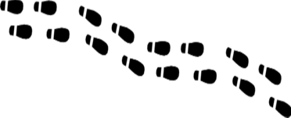
How do you get to your neighbor’s house?
You walk out your door and over to the house
Your houses are “adjacent” so getting there is a direct “hop”
You don’t need to consult anyone else about how to get to a neighbor’s house because you have the right pointer
The walk might take about 30 seconds
Notes:
Sometimes the best way to understand how graph databases are different is using a metaphor. We call this metaphor the “Neighbor Walk” metaphor. It has proven very helpful for people that are trying to understand the performance differences between relational joins and a graph traversal.
Let’s say you want to walk out your front door and over to your neighbor’s house. You open the door, point you body to the neighbor’s house and walk over there. Pretty simple. Since your houses are adjacent this is the logical way to do it.

Slide 19
Our Logical Graph Model
LIVES_NEXT_TO
Dan
Ann
If two physical items are related, they have a relationships arc between them and we model it like the above
Relationships are calculated when data is loaded and stored as in-memory pointers
We build normalized “logical” data models that store many links to each of our items
Notes:
Here is the graph “logical model” for this. You might have a vertex for your house, a relationships called LIVES_NEXT_TO as a pre-calculated relationship to your neighbor’s house.

Slide 20


Relational Database Use Indexes
Central
Index
Search: 123 Main St.
You must walk to a central index system
The index system does a “search” given the house’s address
The index system will tell you how to get to your neighbors house
The walk could take 8.5 hours (1,000 x 30 seconds)
Notes:
Here are the steps that are reflective of how a relational databases does joins
Walk out the door
Walk downtown to the DMV where they have a service that tells you how to get to your neighbor’s house
When you get to the DMV you take a number
When your number comes up you get called by a search agent
You give your neighbors name to the DMV search agent
The search agent at the DMV has a list of all the people in your town sorted by their address (called the index). They search the list (using a binary search algorithm) and they finally give you the GPS coordinates of your neighbor’s house.
You take these GPS coordinates, enter them them into your GPS tracker and follow the directions to Ann’s house.
Now granted the metaphor is not perfect. The speedup really depends on how many rows each table has. However, this metaphore helps you remember that sometimes directly addressing a memory location that is pre-calculated for you at load time can sometimes be three orders of magnitude faster than searching for something every time you need to access it. RDBMS systems try to minimize this search time by doing clever things like caching. However the more data you have the longer the searches take. Direct memory access will always be faster than doing a search!
Now lets also look at some different architectures than a single node graph.

Slide 21
The Knowledge Triangle
How of graphs capture organizational knowledge.
Knowledge
Information
Data
Notes:
Link: https://medium.com/@dmccreary/the-knowledge-triangle-c5124637d54c

Slide 22

How do we store knowledge?
What exactly is “knowledge”?
How is knowledge different from raw data and information?
What is knowledge engineering?
What is knowledge architecture?
How does this relate to AI and data science?

Slide 23
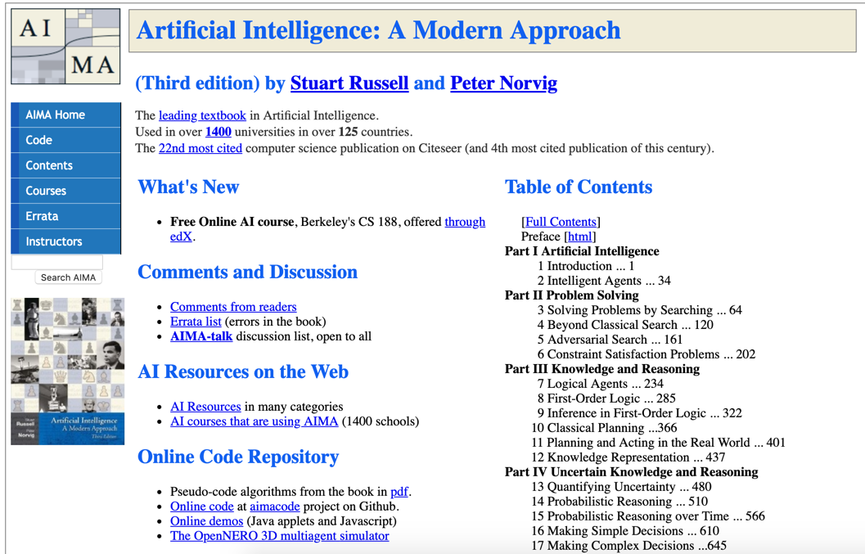
Notes:
http://aima.cs.berkeley.edu/

Slide 24
The Knowledge Triangle
Wisdom & AI
Also known as the “DIKW” pyramid
Diagram for representing the relationships between data, information, knowledge, and wisdom
Too often we focus on “Big Data” and not enough on connected knowledge and transferrable knowledge
Graphs are connected information concepts
Wisdom is reusable across multiple context
Can we capture knowledge in a form that can be reused across multiple domains?
Knowledge Patterns Relationships
Information - Concepts
Data - Binary, Codes, Data Lakes
Notes:
Now lets take a look into some of the reasons that organizations are moving toward knowledge graphs as ways to connect and reuse data. The structure we used to describe this system is called the DIKY pyramid. It is a triangle with Data at the bottom, Information at one level up, Knowledge (in the form of a graph) at the third level and Wisdom at the top. The Wisdom is the layer most strongly associated with AI. When we think of going to the top of the mountain and we ask the Gurus for advice, we are asking them to apply their knowledge to our specific problem. We are asking them to transfer knowledge to our context.
https://en.wikipedia.org/wiki/DIKW_pyramid

Slide 25
Data Lakes Today
100s of Data Scientists
100s of R and Python Libraries
80% of effort is “Data Engineering”
20% is Data Science
Data Access Code
Data Lake
(Data Swamp?)
Very little reuse of code to “understand” and link data
Few people using rules engines and ML to link data

Slide 26

From Raw Data to Wisdom with Continuous Enrichment
Knowledge that can be reused across multiple context
Reusable To New Problems
Wisdom
Connections
De-duplicated
Knowledge
Graph
Consistent
Structure
Continuous
Enrichment
(automated)
Tagged Text
Concepts
Validity
Semantics
Defintions
Searchable
Information
Raw data dumped from a database, log files or documents
Data
Lake
(Data Swamp)
Notes:
This picture follows this same DIKW pattern. However, we want to invoke the idea of raw binary data at the bottom with binary symbols that have little meaning without context.
The second layer is where we identify the nouns in our documents for data. We look for people, places and things in the byte stream. This is where we can understand isolated data – know the types, the definitions of the types and be able to validate if the 1s and 0s make sense within a narrow context.
The third layer is where we start to tie our Nouns together in a graph. It is where we build relationship links between things. It is where we might look for duplicated data (Master Data Management), where we check for consistency and we verify the patterns of connections are consistent.
The highest level is where we restructure our graph so that it comes in sub-graphs that are reusable across multiple applications. We can provide consistent APIs that pull data in consistent ways and these interfaces are reusable across many domains.
Central to this pyramid is the concept of continuous enrichment cycles. As we discover new things at a higher level, we sometimes provide feedback to lower levels.

Slide 27

The Open World Assumption
Anyone can add any new information at any time.

Slide 28
Schema agnostic (Schema-free, Schema-less)
SQL databases have a fixed database schema
The schema is created at design time before data is loaded
The schema typically contains fixed structure and fixed indexes
Data can be loaded into a table from a CSV file for that table
Graph (and document) databases don’t usually have a fixed database so they are called schema agnostic
Data is loaded “as is” and no modeling needs to be done before a load
The metadata that is associated with the load script is used to index the data
Schema agnostic systems are ideal for big data, integration hubs and highly-variable systems
Fixed Schema
Schema Agnostic
https://en.wikipedia.org/wiki/Schema-agnostic_databases

Slide 29
Graphs and the “Open World” Assumption
Past: Closed Word
Graph: Open World
CLOSED!
Everything is prohibited until it is permitted
You can only add data that you model
Data modeling team become gatekeepers
Everything is permitted until it is prohibited
Anyone can easily add any data at any time without disruption of services
Data models quickly evolve
Notes:
There is another way to describe the differences between fixed and schema agnostic. This is related to the way that logic systems make assumptions about unknown data. Many relational database use logic that imply that missing or unknown data is always false. Graph databases use an assumption that unknown data is usually unknown. This is known as the Open World Assumption (OWA).
https://en.wikipedia.org/wiki/Open-world_assumption
http://www.mkbergman.com/852/the-open-world-assumption-elephant-in-the-room/

Slide 30
The Jenga Tower
How do small changes in the model impact your queries and reports?

Slide 31
How does a small change impact the stability of your queries?
1,000 SQL or SPARQL queries that need to be changed
We need to add one new property to this relationship
What is the blast radius?
How do we prevent one small change in our model from disrupting 10,000 queries and reports?
Why are labeled property graphs more flexible than relational and RDF models?

Slide 32
Other Stories, Metaphors and Blogs
The Deep Learning Bartender – why machine learning limits explainability
The Adversarial Turtle – how deep learning computer vision algorithms lack understanding
Knowledge Graphs and Emergence – how large graphs evolve
The Racoon and the Panda – the role of specialization in databases and processors
Lakes, Hubs and Graphs – the trend towards toward real-time analytics
Lost in [Knowledge] Space – the use of concept graphs in learning management systems
The Enterprise Knowledge Graph Brain – metaphors that leverage biological systems
Blockologies - A pattern language for AI data flows
Alexa: Create an outline for me on graph databases – how graph algorithms summarize content

Slide 33

The Deep Learning Bartender
Can I Recommended a Drink?

Slide 34
The Deep Learning Bartender Dialog
A patron walks into a deep learning (DL) bar.
Patron: I hear you recommend great drinks here.
DL bartender: Yes, we do!
Patron: What should I have?
DL Bartender: From the looks of you, you should have a Gin and Tonic. Patron: Why do you say that?
DL Bartender: I have no idea.

Slide 35

Explainable AI Models are Graphs
Traditional ML Only
Task
Why did you do that?
Why not something else?
When do you succeed?
When do you fail?
When can I trust you?
How to I correct and error?
Training
Data
Machine
Learning
Process
Learned
Function
Decision or Recommendation
Explainable AI
Task
I understand why
I understand why not
I know when you succeed
I know when you fail
I know when to trust you
I know why you erred
Training
Data
New
Machine
Learning
Process
Explanation
Interface
Explainable Model
https://www.darpa.mil/program/explainable-artificial-intelligence
Notes:
Explainable AI is a key
https://www.darpa.mil/program/explainable-artificial-intelligence

Slide 36
Our Brains are Graphs
84B neurons
10K Connections per neuron (degree)
Notes:
Be careful how you use brain metaphors. The brain has a much different architecture than an enterprise knowledge graph. The degree of a EKG is typically around 10, not 10,000. Relationships in the brain are active and both enrich and suppress signals between neurons.

Slide 37
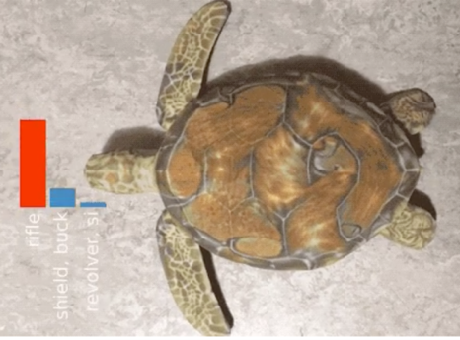
The Adversarial Turtle
2017 Verge Article on AI
Use a 3D printer to print a turtle
Place different “textures” on the shell
Most image recognition algorithms fail
On CNNs: “On a very fundamental level, our work highlights how far current CNNs are from learning the 'true' structure of the world”
rifle
99% of modern image recognition is just simple (but precise) texture matching
Notes:
https://www.theverge.com/2017/11/2/16597276/google-ai-image-attacks-adversarial-turtle-rifle-3d-printed

Slide 38
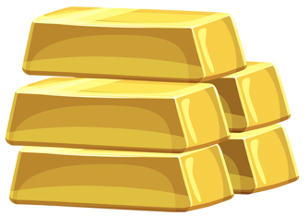
Structure is the new gold in data mining

Slide 39
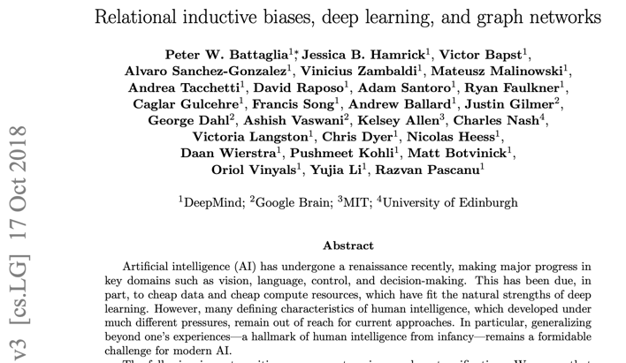
2018: Graphs Join with Deep Learning
Notes:
https://arxiv.org/pdf/1806.01261.pdf

Slide 40
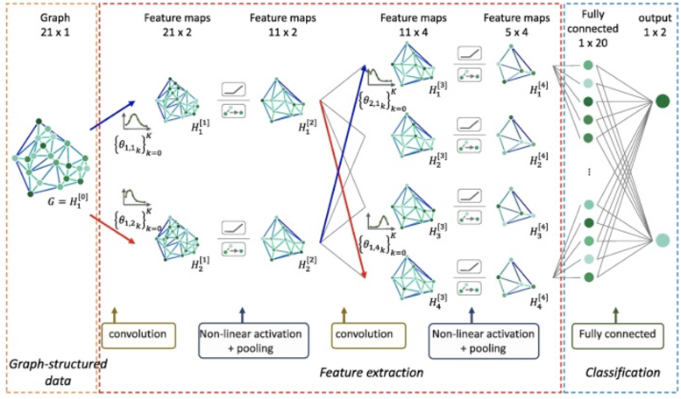
Graph Convolution Neural Networks

Slide 41
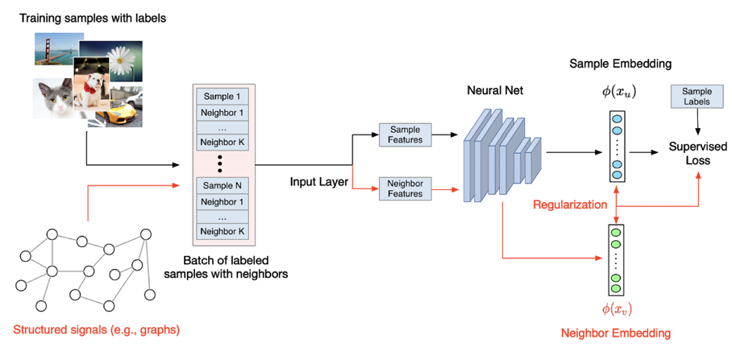
Google Neural Structured Learning in TensorFlow
Notes:
https://medium.com/tensorflow/introducing-neural-structured-learning-in-tensorflow-5a802efd7afd

Slide 42

Three Eras of Computing
1) Procedural Era
Data
Programs
Answers
Procedural Code (Rules)
Explanations (Why)
2) Machine Learning Era
Data
Machine
Learning
Rules (10M weights)
Answers
3) Graph Era
Data
Knowledge
Answers
Machine
Learning
Explanations (Why)

Slide 43
Testing your stories
Present your stories to key decision makers
Do it face-to-face if possible
Gauge their reactions – look for “ah ha” moments
Wait two weeks to let them discuss the concepts in their local teams
Come back after two weeks and ask them to explain “why graph” to you
If they can’t explain a topic, reinforce the story
If you have consistent failure of retelling then find other stories
The best Solution Architects also tell great stories.

Slide 44
Coming Soon: Hardware for Graph
Algorithmic
Richness
Enterprise
Knowledge
Graph
Hardware
Graph
Single Node
Graph
Data Hubs
Data Lake
Scale out

Slide 45
Find Out More
Medium Blog: https://medium.com/@dmccreary
LinkedIn: https://www.linkedin.com/in/danmccreary
Share your own stories!
Tell us what stories work
Tell us what stories don’t work

Slide 46
Dan.McCreary@optum.com

